Slide 1

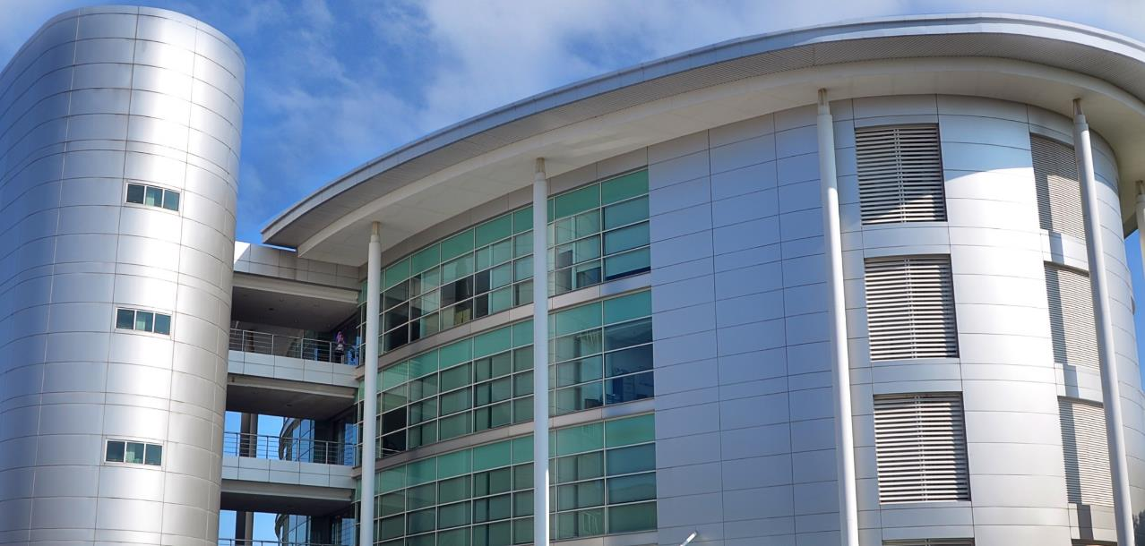

IT SERVICE DIVISION
Notes:
Hi, Assalamualaikum & Very Good Morning, Where is Melaka Campus? Hi Melaka Campus! How are you today? Dah breakfast? Ada yg dh homesick ke?
Welcome all to Multimedia University for the new academic year 2021/2022.
My name is Ayuni Binti Amran. I will walk through with you the main IT services provided in MMU.

Slide 2

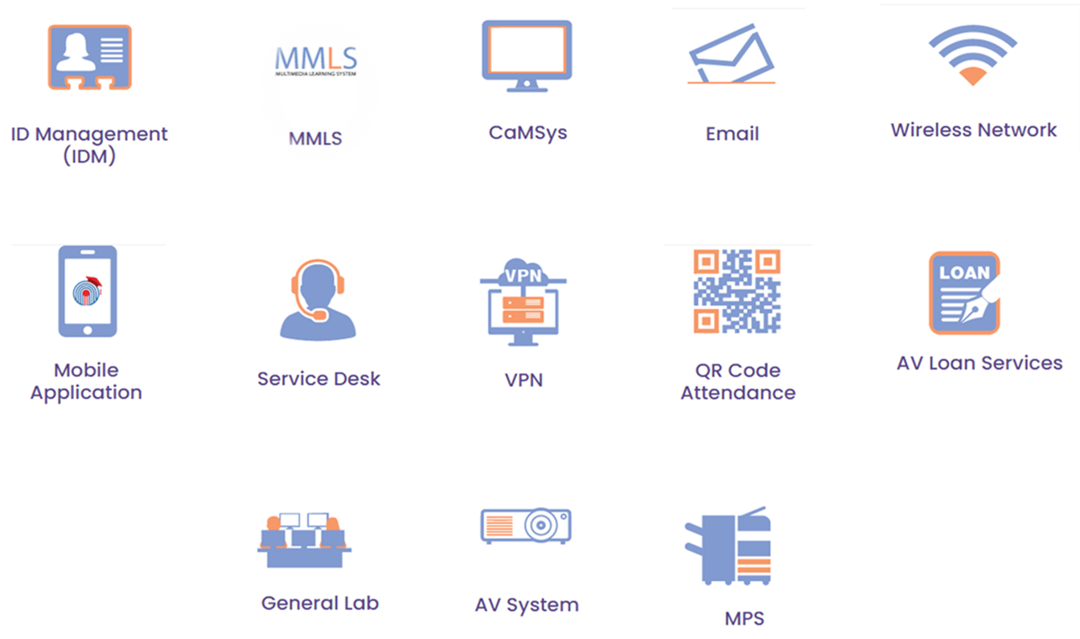
Notes:
Basically, this is the services provided by ITSD. The most services that related to you guys such as IDM, MMLS, Camsys, Mobile Application, Email, & Service Desk.

Slide 3

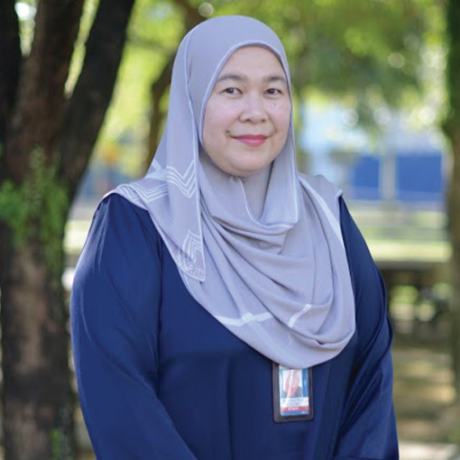
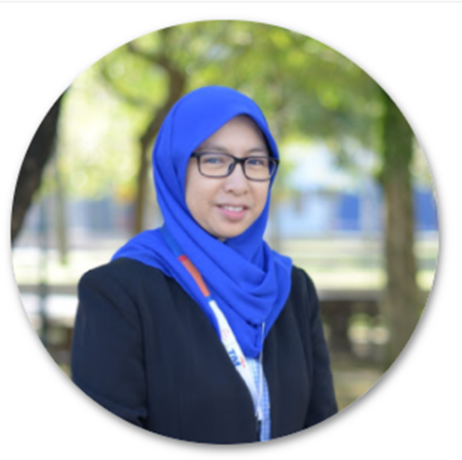
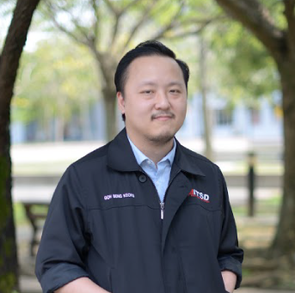
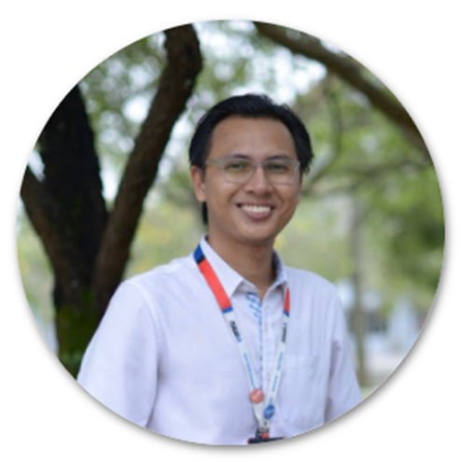
HIGH LEVEL ORGANIZATION CHART
ASSISTANT GENERAL MANAGER/HEAD
Rita Kazirah Ab Rahim
SENIOR MANAGER BUSINESS OPERATION & IT GOVERNANCE
Fauziah Md Jaafar
MANAGER MULTIMEDIA PRODUCT INNOVATION
Goh Beng Kiong (Acting)
SPECIALIST
MEDIA SUPPORT UNIT
Ahmad Hafidzuddin Abdul Aziz
Notes:
This is High Level Organization Chart of ITSD
ITSD is led by Ms Rita Kazirah Bt Ab Rahim and assisted by 3 Unit Managers,
Ms Fauziah incharge for Business Operation & IT Governance,
Mr Goh Beng Kiong currently the acting Head for Multimedia Product Innovation Unit and
Mr Ahmad Hafizuddin the Head of Media Support Unit

Slide 4
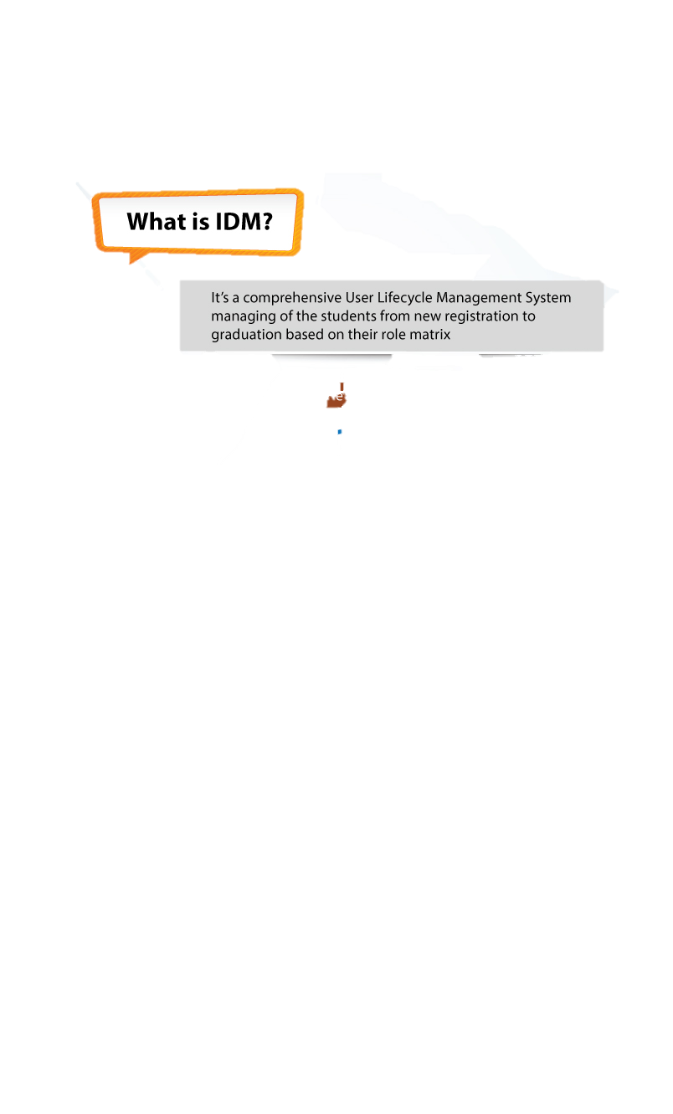
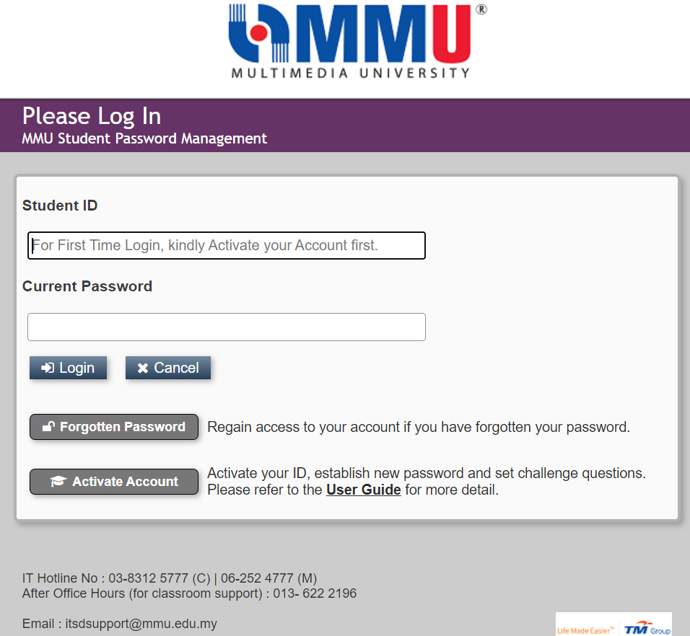
IDENTITY MANAGEMENT (IDM)
https://spm.mmu.edu.my
  Student Password Management (SPM)
  To allow Student to perform Self Services
    ID Activation
    Password Reset
    Set Security Questions
Objective of SPM
Single password to access all applications except WiFi service (to be integrated soon).
Your password supplied in the offer letter will expired on end of week 2 of academic calendar.
Notes:
Now, let me brief you about IDM. Once you registered as MMU Student, you will get your MMU ID or Identity Management (IDM) in your offer letter provided by Admission. Your initial password supplied in the offer letter will expired on end of week 2 of academic calendar. Please take note and immediately change it.
Your username is always your Student ID No. and please remember the password that you have saved.
The IDM will be used to access all IT Applications and Services within MMU.

Slide 5
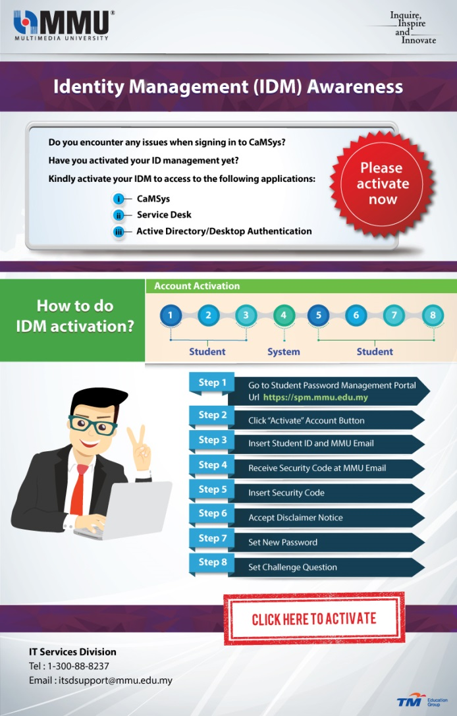
IDM ACCOUNT ACTIVATION
Notes:
Once received your IDM credential, you must activate your account at SPM Portal. Please follow step 1 until step 8.
I’ve prepare a video guideline for you. Let’s watch together.

Slide 6


IDM ACCOUNT ACTIVATION

Slide 7

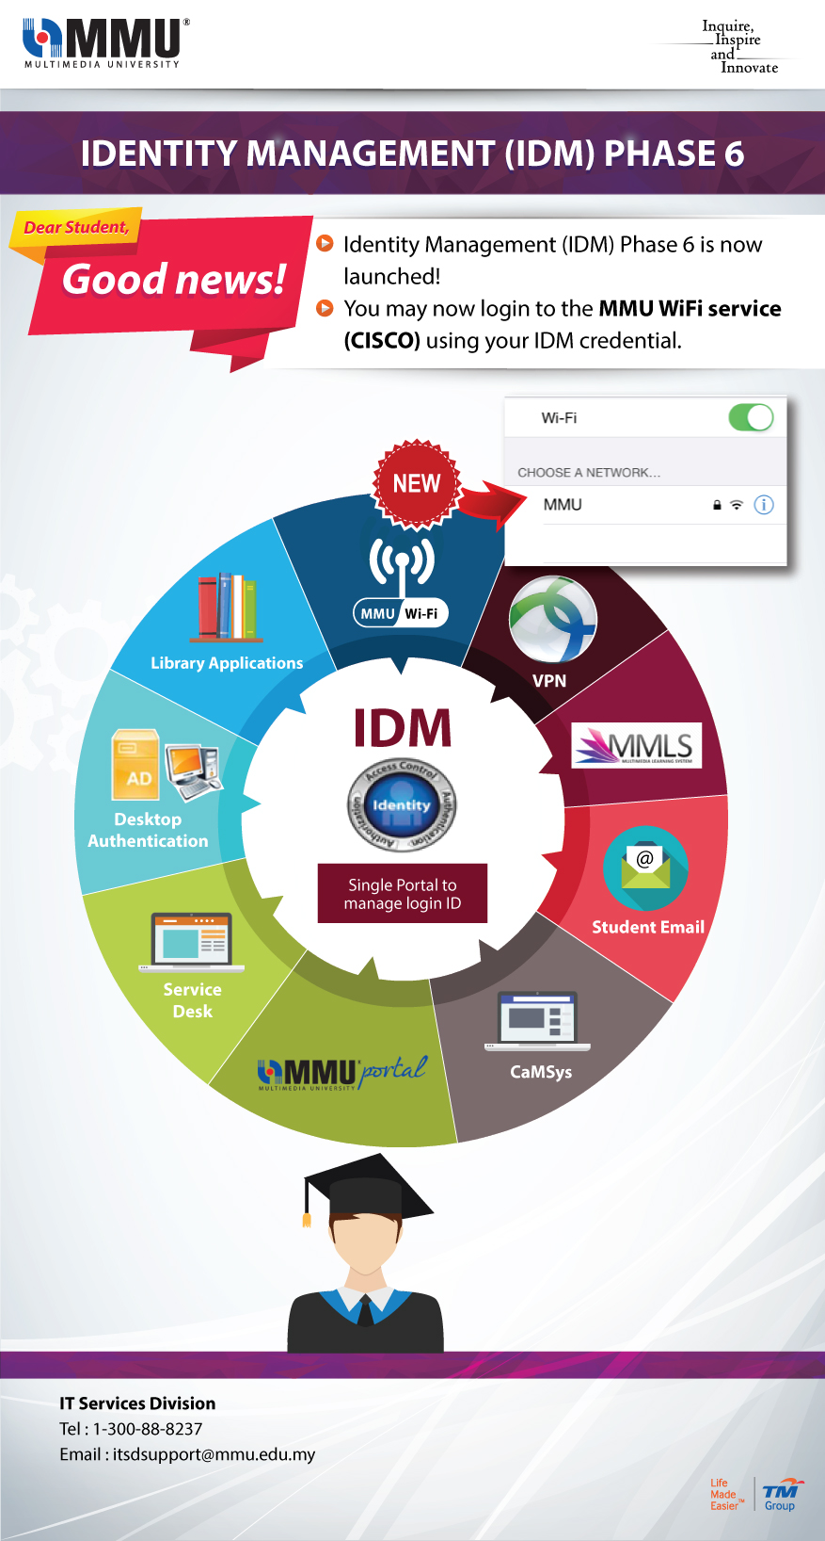

CREDENTIAL FOR NEW STUDENT
Notes:
These are among the IT applications and services within MMU that using IDM.
‘Read’
Don’t worry, if you missed the video just now, you may visit ITSD Portal to get the guideline

Slide 8
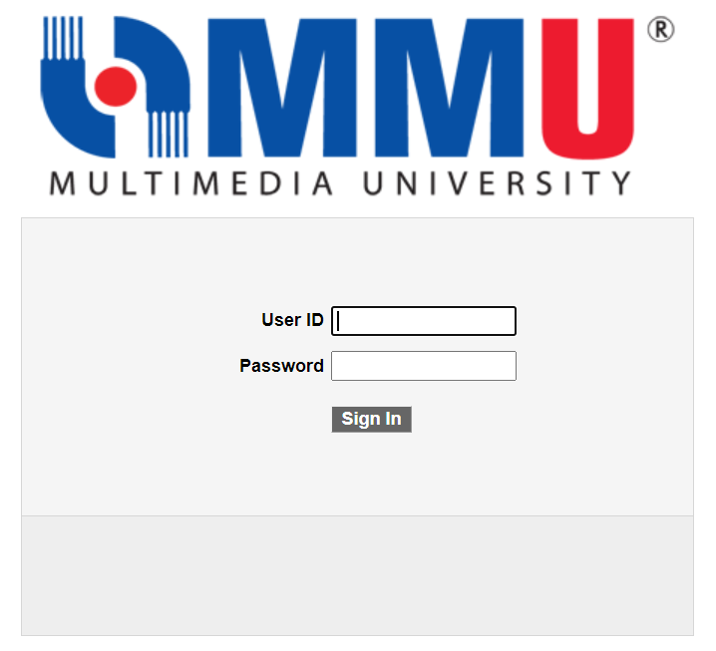
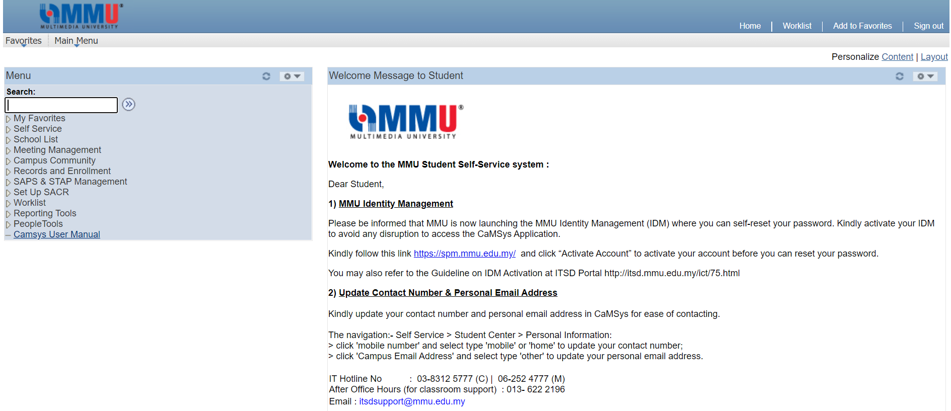
CAMPUS MANAGEMENT SYSTEM (CaMSys)
  CaMSys is self-service portal for students to manage (not limited to) :-
  Course registration
  Selection of modules
  Check examination results
  Payment status
  Student attendance
Notes:
Campus Management System or CaMSys is a comprehensive campus solution for Student & Academic related system. It supports the full student lifecycle from prospects through enrolment to alumni management.
‘Read’
Please explore the features to familiarize yourself with CaMSys.

Slide 9
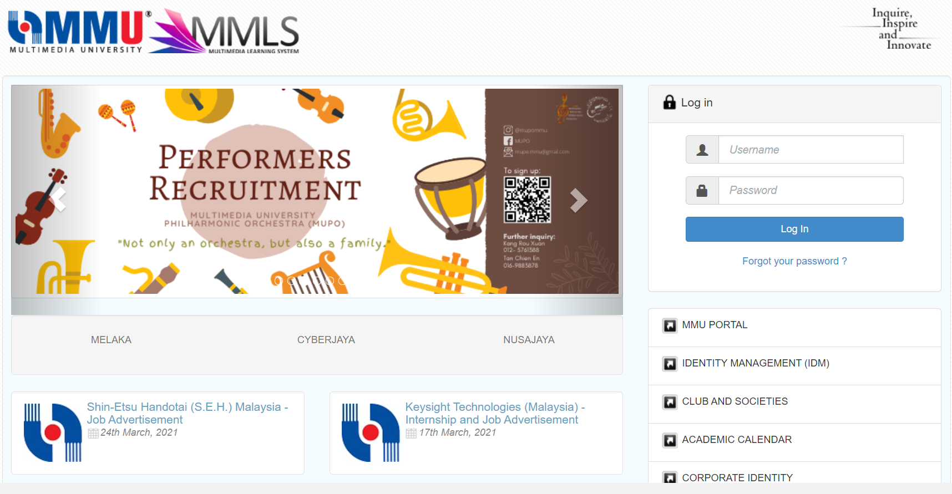
MULTIMEDIA LEARNING SYSTEM (MMLS)
https://mmls.mmu.edu.my
Notes:
What is MMLS
To help your learning journey more easier, you may use Multimedia Learning System or MMLS.
Please note that your account is activated when subject already registered in CaMSys. You may access it from the url : mmls.mmu.edu.my

Slide 10
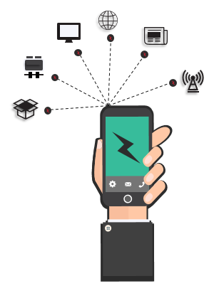
MULTIMEDIA LEARNING SYSTEM (MMLS)
Why I need to access MMLS?
To read/download my learning material or lecture notes
To read latest announcement from my lecturers regarding my courses
To read the my course material at own pace
To submit my assignment
To communicate with my peers and lecturers
Notes:
Why you need to access MMLS?
To read/download learning material or lecture notes
To read latest announcement from lecturers regarding your courses. Sometime, you may get other announcement posted by ITSD or STAD
To read the course material at own pace
To submit assignment
In MMLS also you can communicate with peers and lecturers

Slide 11
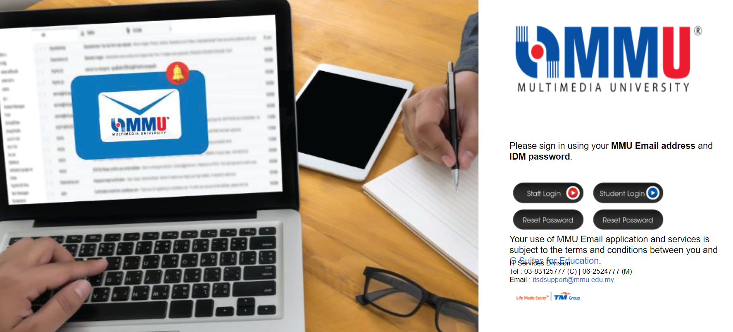
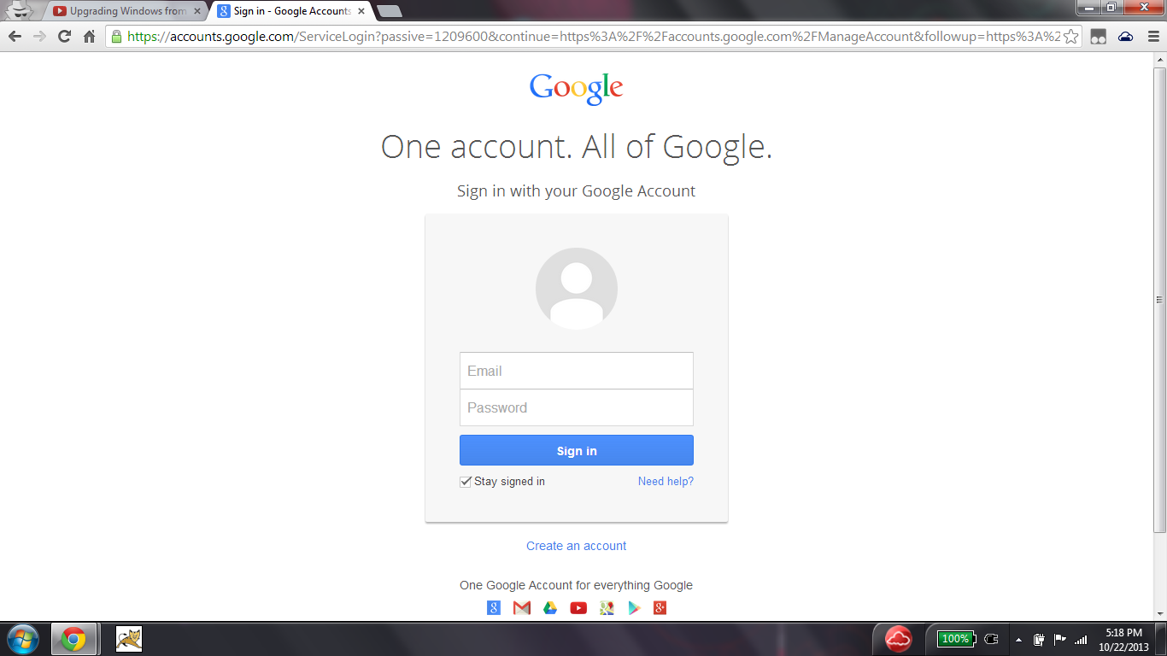
OFFICIAL MMU EMAIL
studentID@student.mmu.edu.my
Key in using your IDM password
http://mail.mmu.edu.my
Student are advised to check the MMU official email regularly for any announcements and updates.
Notes:
Each student will be provided with an official email account.
Your email address is your student ID number followed by '@student.mmu.edu.my’ (e.g. 110110111@student.mmu.edu.my).
You may use the Email account as the official communication channel between you and the University. Therefore, you must always check your email mailbox because sometime the university will share the latest update through your email.

Slide 12
WIRELESS NETWORK
Provider available at MMU :
1
“WIFI@MMU”
This service is powered by TM
The coverage has been expanded to cover more of campuses areas
Notes:
Currently there is only 1 provider available at MMU which is WIFI@MMU
WIFI@MMU is wireless service powered by TM which available throughout campus; Cyberjaya and Melaka.
To access to the service, please connect to SSID “Wifi@MMU” through your device.

Slide 13
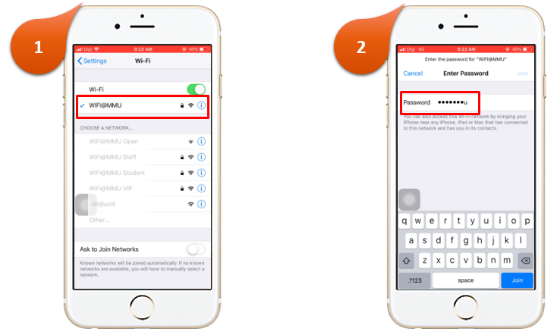
STEP TO CONNECT > WIFI@MMU
For first time connection,
select SSID : WIFI@MMU
Enter Passkey password : wifi@mmu
Now you are connected to the internet.
Notes:
How do you connect to WiFi@MMU?
‘Read’
The next time you login, it will connect automatically when detecting WiFI@MMU SSID.

Slide 14
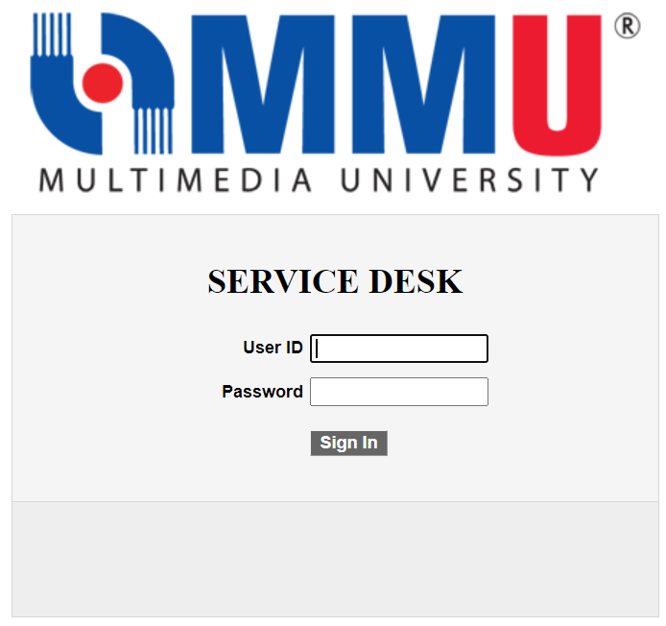
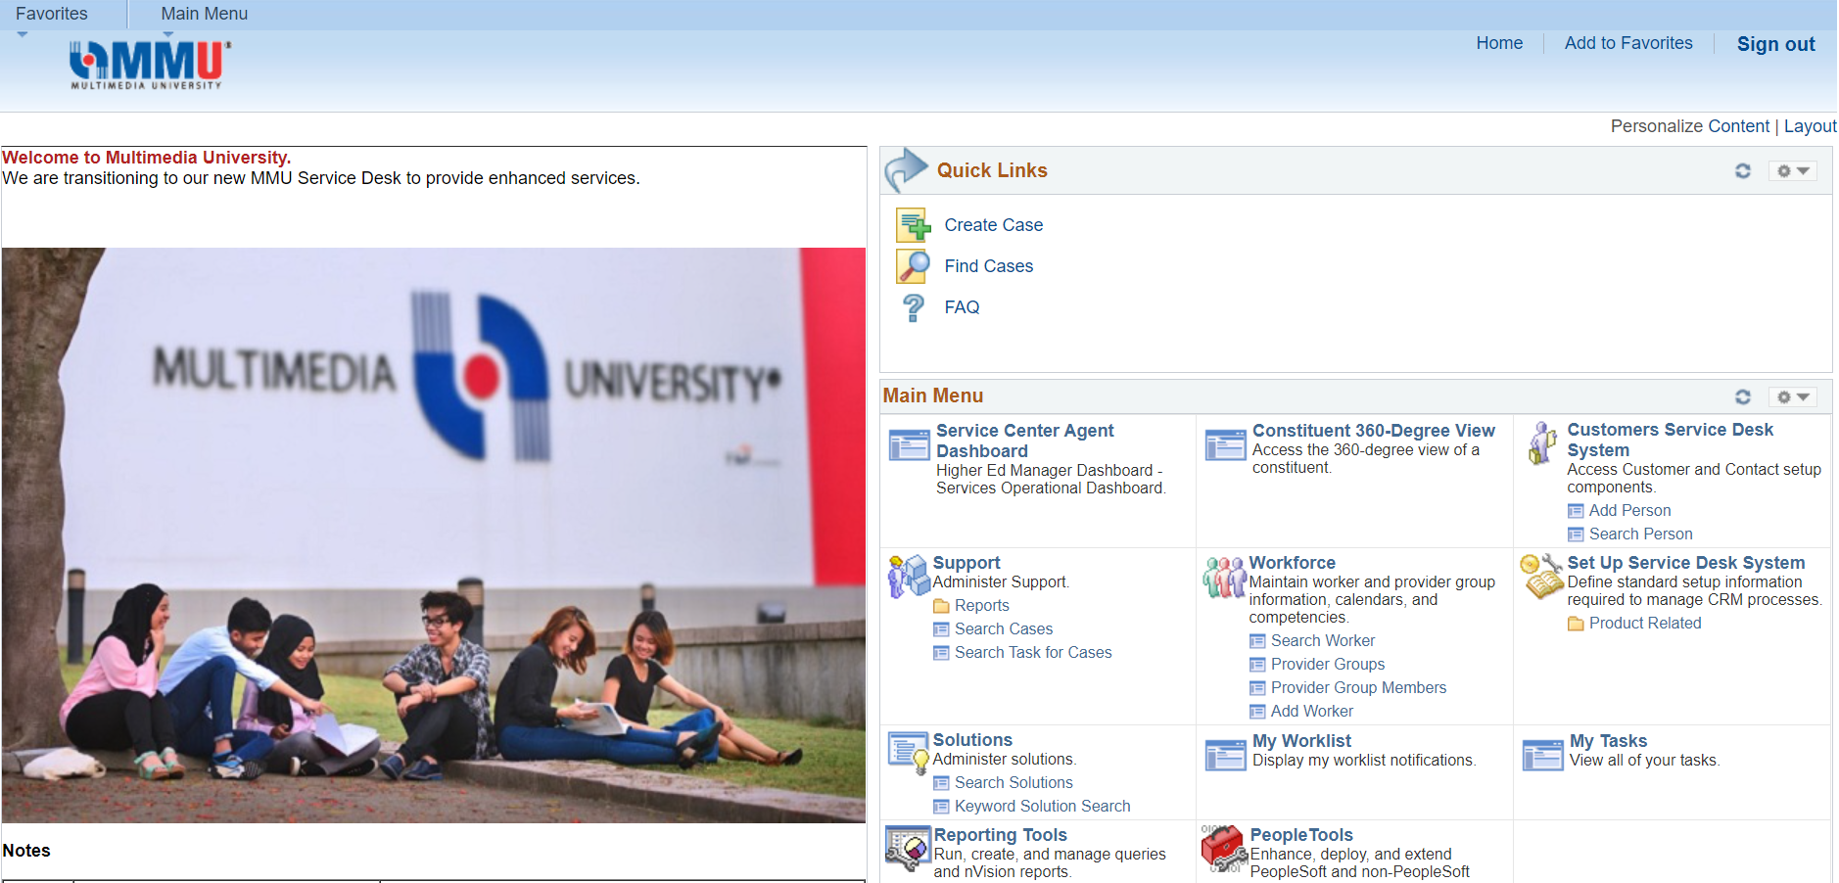
MMU SERVICE DESK
Use your login credential
Password is case sensitive
Please select IT if you encounter any problem related to IT Services
Notes:
This is also very important. Please pay your attention to this.
Service Desk is a system that manages MMU user’s service request, incident, suggestion and complaint.
You may access the system at the MMU Online main page and use your IDM credential to login.
‘Read’ if you encounter…

Slide 15
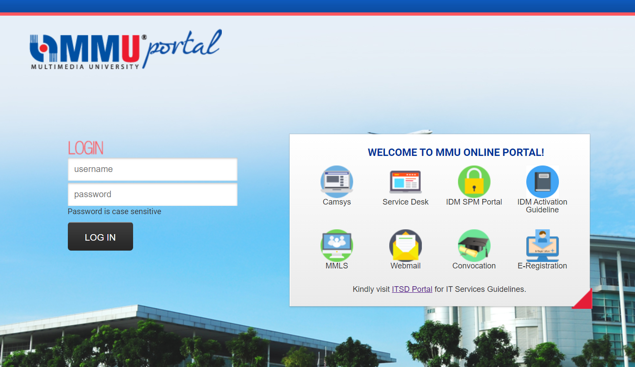
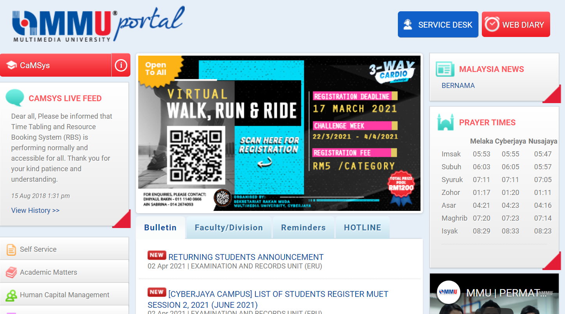
MMU ONLINE PORTAL
https://online.mmu.edu.my
Notes:
You may access MMU Online Portal for various services and application such as WIN Program Page, Bulletin Board, Video Guidelines and etc.
Kindly login using your IDM credential.

Slide 16
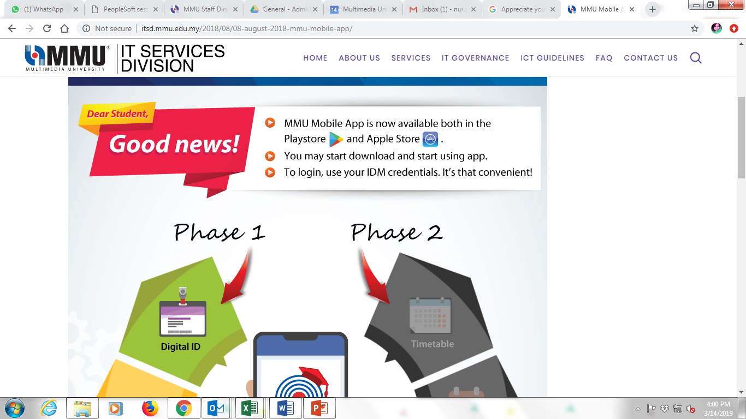
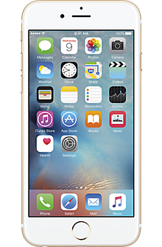
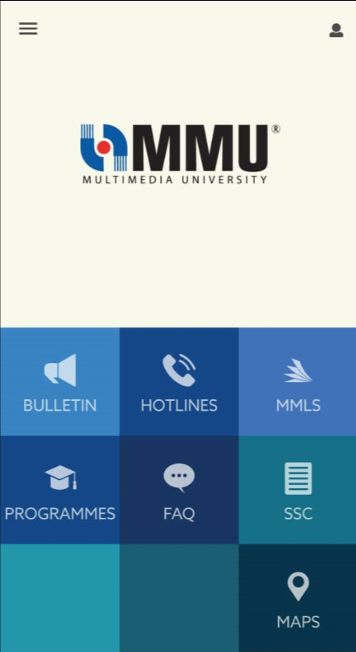


MMU MOBILE APP
View notes, subjects, timetable, outstanding bill and lecturer announcement
Submit selected forms through the app
Easy navigation
Notes:
Now students are able to navigate through the campus at ease.
The MMU mobile app covers critical features such as the Student Digital ID, announcements, campus map and access online forms.
These apps are downloadable for both android and ios.

Slide 17
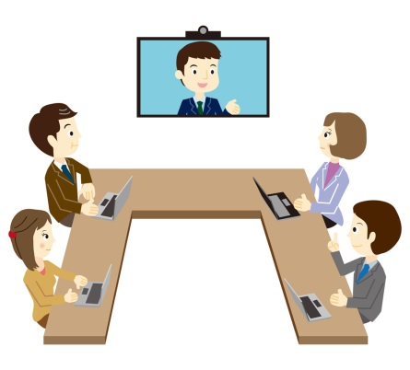

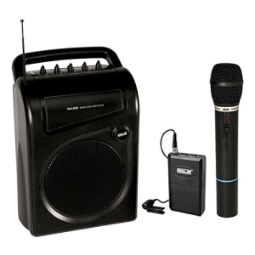
AV SERVICES
Please take note that you need to request our service at least 3 working days before actual event.
Provide AV technical support for teaching, meetings, seminars and conferences
Equipment maintenance and troubleshooting
Portable PA
(Mic, Amp and speaker)
Notes:
This is other services provided by ITSD.
We provides audio video services for academic and administrative purposes i.e CPU, monitor, projector screen, sound system, projection system and microphone, or any system that related with audio/visual at classroom, halls, selected labs (NMES Lab Cyberjaya and NMES Lab Melaka) and meeting rooms.

Slide 18


AV SERVICES
Student Events / Activities
Events/activities conducted on Campus using the existing rooms which have AV equipment
Events/activities conducted outside campus or outside the classroom
Late request/return
Notes:
So, after this if you are active with student campus activities you need to know with whom you need to liaise to get all the services.
It is free of charge for the event conducted on campus using existing room which already have AV equipment
While, if the activities conducted outside campus or outside classroom there is some charges.
Please be reminded, late request or return, damage, lost also incur some penalty charge.

Slide 19
AV SERVICES – APPLICATION PROCESS
Fill up the AV Services / Equipment Loan / Transfer Format Form at the Media Support Unit
Rental charges are listed on the Application Form
Submit form to MSU Officer
Notification will be given to successful application
Notes:
These are the steps for you to follow for the AV services application.
Fill up form (Intranet) – please make sure you make the request at least 3 working days before actual event.
Each rental charge stated in the form
Then, submit form to ITSD Office
Once your application has been approved, ITSD will notify you to collect item or proceed to use the equipment.

Slide 20
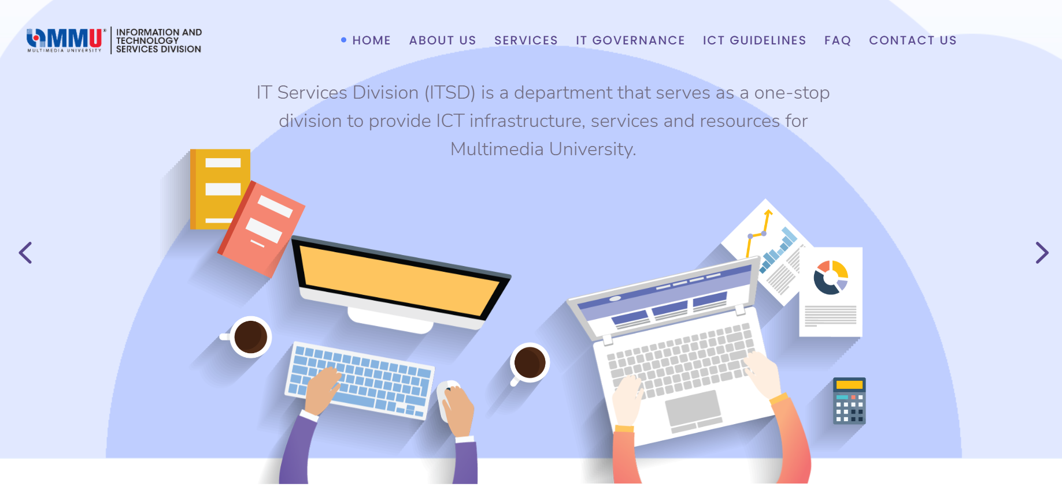
ITSD PORTAL
All guidelines to IT services available here
http://itsd.mmu.edu.my/
Notes:
Kindly visit ITSD Portal for further information such as current updates or guidelines.
Go to your browser and search for itsd.mmu.edu.my.
We also share important updates through Media Social, FB and Instagram, just search for ITSDMMU. Please LIKE and follow us.

Slide 21


CONTACT US
For IT Services Related
Office Hour (08.30am – 5.30pm)
Cyberjaya : 03-8312 5777
Melaka : 06-252 4777
For Audio/Video/Classroom Support
After Office Hours : 013- 622 2196
itsdsupport@mmu.edu.my
For other inquiries/request services/problem related to ITSD Services,
please submit case via MMU Service Desk.
Notes:
Need any assistance related to IT Services, you may reach us through phone call or email as follows:
Please call us within office hour 8.30am to 5.30pm, if you want to talk to us.
Others, you may also email us. The email send after 5.30pm, we expected to reply back by the next working day.
Just to highlight, ITSD Support will immediately entertain for the issue related to IT Services. While, for other issue such as related to subject registration, finance, hostel registration, ITSD will pass to the related PIC to help you. It may take sometime to reach the correct PIC.

Slide 22

IDM ACCOUNT ACTIVATION
Notes:
That’s all from ITSD.
Any Question? 1 2 3 4 5
If you have anything to ask after this, you may send us an email or lodge your report through Service Desk System. 1 2 3 4 5
THANK YOU. ALL THE BEST ….

